Slide 1
Machine Learning A-Z™: Hands-On Python & R In Data Science
Kick-off session
May 24, 2019
Ariel Capetillo
Juan Carlos Urrutia

Slide 2
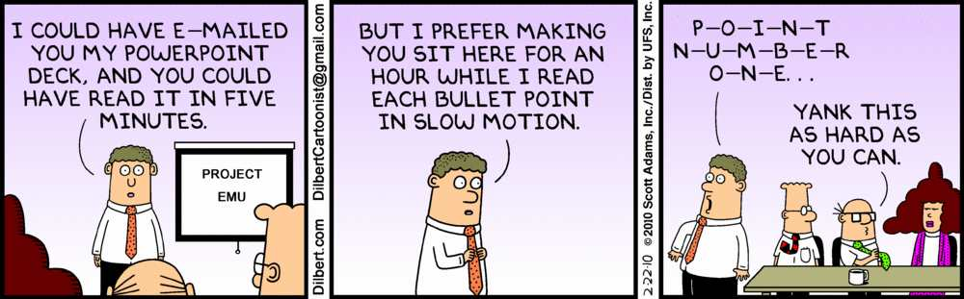
Contents
01 |  | Introduction
02 |  | Course Content
03 |  | Data Preprocessing
04 |  | Linear and Multiple Regression
05 |  | Logistic Regression
06 |  | Decision Trees and Random Forests
07 |  | Clustering
08 |  | Association Rules
09 |  | Natural Language Processing
10 |  | Artificial Neural Networks
<number> / evalueserve.com
©2017 Evalueserve. All rights reserved.

Slide 3
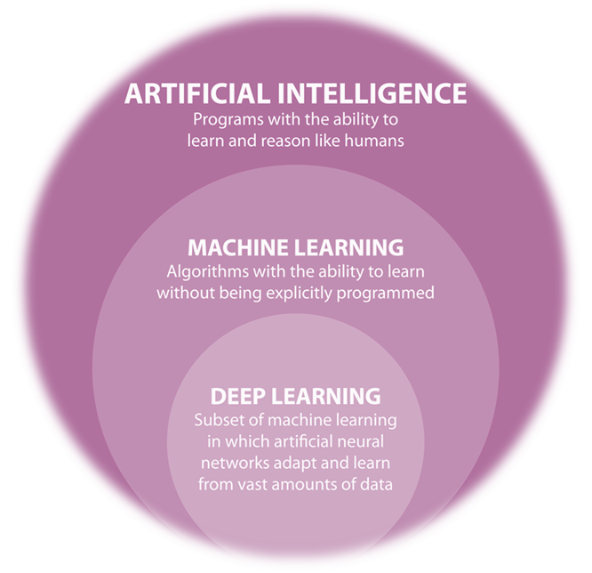


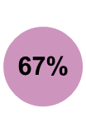
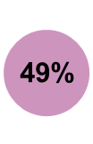

Introduction
Machine learning uses the current hardware capabilities to generate predictions or relations based on historical data.
This course is focused on step-by-step programming tutorials for different ML techniques.
<number> / evalueserve.com
©2017 Evalueserve. All rights reserved.

Slide 4
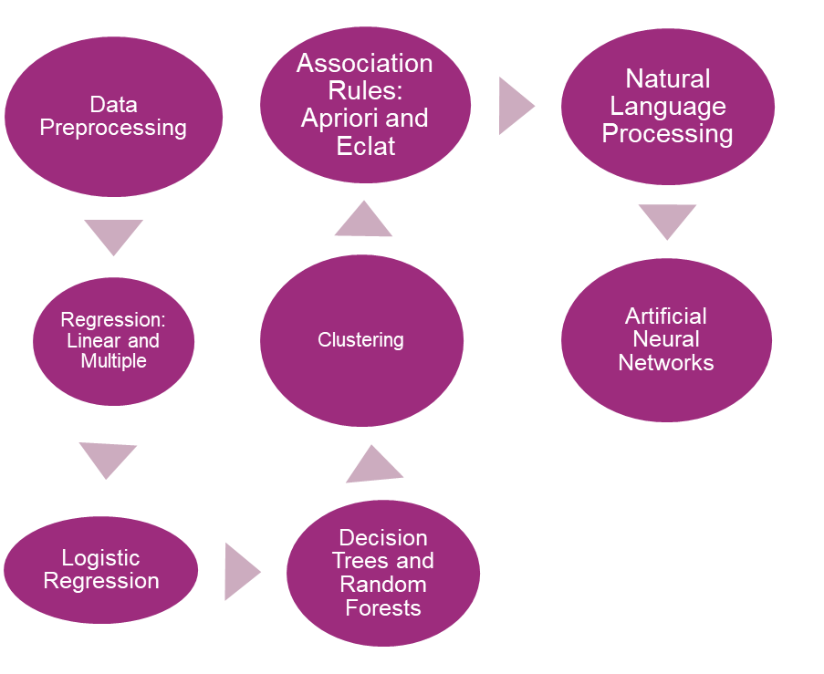



Course Content
Led by Hadelin and Kirill, the path that we will follow is:
<number> / evalueserve.com
©2017 Evalueserve. All rights reserved.

Slide 5
Machine Learning Techniques
Let’s make the complex simple…
©2017 Evalueserve. All rights reserved.

Slide 6

1: Data Preprocessing
Description
Experienced Data Scientists recommend to take a serious approach on dealing with this section.
This include (among other things):
Get and import a dataset
Import libraries
Deal with missing values
Identify Categorical data
Splitting a dataset into training and testing sets
Feature Scaling.
How an analyst can use it
This piece of work has to be applied on every one of the ML Models for every business case dealt with them.
1hr 43min
<number> / evalueserve.com
©2017 Evalueserve. All rights reserved.

Slide 7

2: Linear and Multiple Regression
Description
By definition and simplicity, Regression for Numerical data is considered the base lesson for dealing with models.
Consists on defining a dependent variable (Y) which value can be obtained from the formula
How an analyst can use it
Even though the Simple and Multiple Regressions are not widely applied on Business Cases, they are often considered the first type of models to start learning from.
Useful for simple datasets and examples.
3hr 46min
<number> / evalueserve.com
©2017 Evalueserve. All rights reserved.

Slide 8
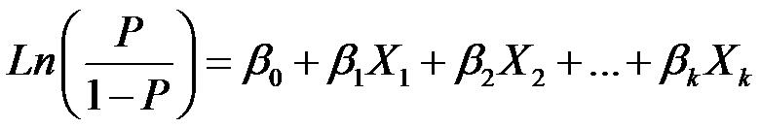
3: Logistic Regression
Description
This model consists on dealing with the Odds probabilities on a formula which can deal not only with numerical, but also categorical data.
By default, the formula is:
How an analyst can use it
By default, this technique is used for almost 80% of Business Cases for two main reasons:
Even though its formulation is not quite simple, it is understandable and can deal with any type of data.
And it is stable. The real precision tends to be near from the base logistic regression model.
1hr 43min
<number> / evalueserve.com
©2017 Evalueserve. All rights reserved.

Slide 9
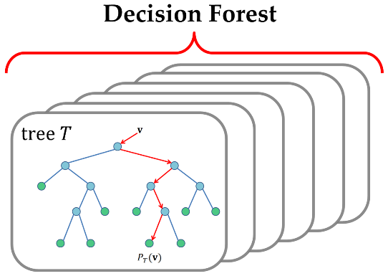
4: Decision Trees and Random Forests
Description
Classification algorithms. Decision trees work by splitting data up along its dimensions into smaller data cells, with the aim of decreasing the overall entropy of the data within each cell.
Random Forests follow that principle, but instead of using just one "Tree", it consists on computing, randomly, a series of multiple trees to improve the accuracy of the model.
How an analyst can use it
A typical application would be used to classify data into a predefined target field.
An example field might be high probability of churn or even a numeric value such as an estimated price in the case of regression trees.
Decision trees are also used to explore which are the most important fields for a particular data set, which then can be used in other algorithms and Business rules.
1hr 32min
<number> / evalueserve.com
©2017 Evalueserve. All rights reserved.

Slide 10
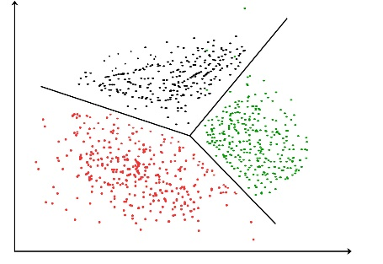
5: Clustering
Description
Cluster detection is simply the automation of finding meaningful patterns within a data set.
Often the problem in data mining is not a lack of patterns but identifying which patterns are useful amongst the noise of possibly hundreds of competing patterns within the data.
These techniques penetrate this noise by finding clusters of data that form natural groupings within the data set.
After clusters have been detected, they are often themselves the object of study.
How an analyst can use it
Clusters essentially breaks a complex problem up into much smaller manageable pieces where a human can then easily identify the underlying pattern.
In marketing, clusters are nearly always called segments, which is a popular application of the clustering technique.
2hr 34min
<number> / evalueserve.com
©2017 Evalueserve. All rights reserved.

Slide 11
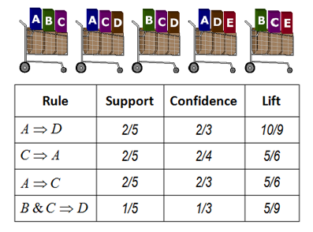
6: Association Rules
Description
Link analysis is part of a subset of mathematics called graph theory, which represents the relationship between objects as edges and the objects themselves as nodes.
This analysis falls under the category of both direct and undirected data mining.
A popular use of link analysis is to create new variables to be used by other modelling techniques, but link analysis can also be used in an undirected way by exploring the properties of the data itself.
How an analyst can use it
Areas where association rules are applied has been particularly successful:
This include identifying key sources of information on the web by analyzing links between pages, finding influential customers from call pattern data to recruit new subscribers from competing networks, etc…
Other sources of information may only imply an implicit link between objects, in these cases the data scientists challenge is to identify the links.
2hr 21min
<number> / evalueserve.com
©2017 Evalueserve. All rights reserved.

Slide 12
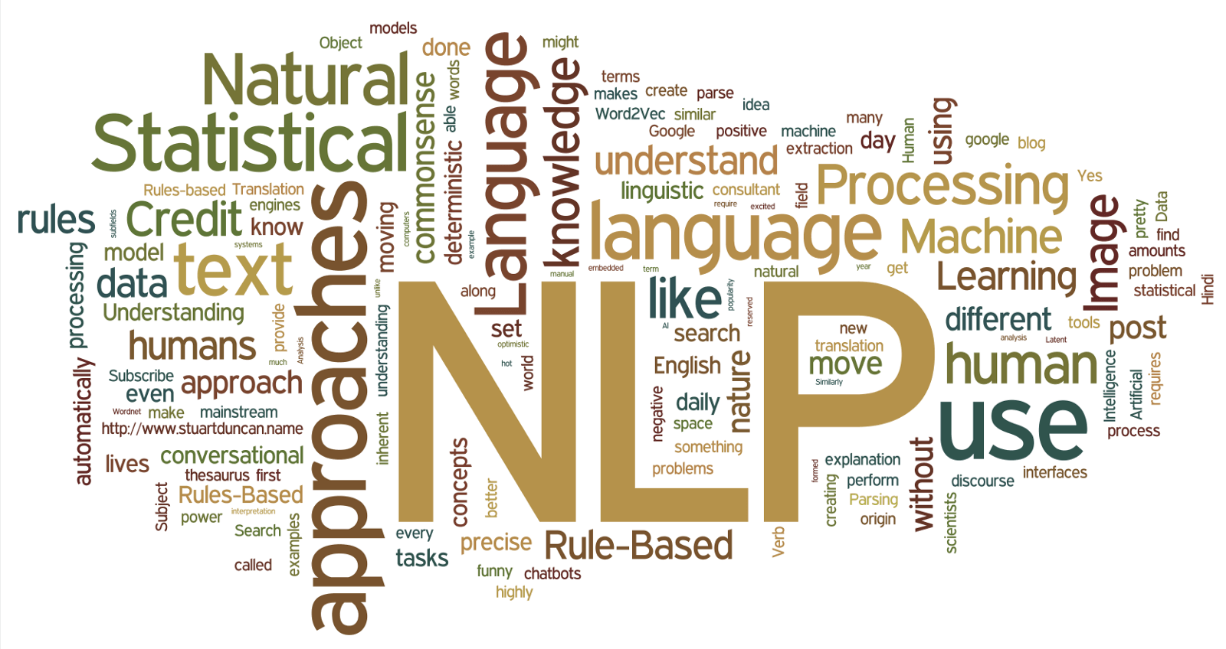
7: Natural Language Processing
Description
With the amount of text being generated in organizations, both internally on reports or CV’s and online in the social media sphere and news reports it has become humanly impossible to read all these documents.
Text analytics algorithms heavily
rely on probability theory and the rarity and occurrence of certain words, which can be used to predict the meanings and themes of the text.
Text analytic techniques are a form of classification algorithm so a target field for the algorithm is clearly defined.
How an analyst can use it
In sentiment analysis, typical target fields would be negative, neutral and positive sentiment.
Another example of target fields would be to classify news articles on whether you expect them to have or not to have an influence on the stock market.
Naïve Bayes is perhaps the popular algorithm for text analytics. Bayes formula was made famous for its use in determining the probability of medical tests false positive and false negatives rates
3hr 1min
<number> / evalueserve.com
©2017 Evalueserve. All rights reserved.

Slide 13
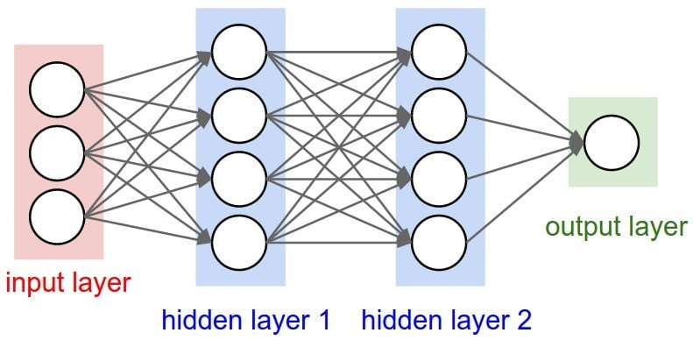
8: Artificial Neural Networks
Description
They are based on the neural networks found in biology and the human brain, where nodes are activated by a signal that in turn transmits a response signal to activate other nodes.
In artificial neural networks, each node is comprised of a combination function that receives various incoming signals and calculates the total received signal based on a set of weights.
A transfer function then outputs a signal based on the total revived signal from the combination function.
How an analyst can use it
Neural networks are a classification type algorithm. The target field would typically be a scoring function, such as the customer’s propensity towards a particular product, or an estimated value for a house.
The algorithms are, however, considered a black box, as they cannot tell you why a certain result was produced. This can restrict the use of neural networks when the question is why does person/ event A lead to action B, but they are exceptionally powerful in answering what is the most likely action B given person/event A.
3hr 47min
<number> / evalueserve.com
©2017 Evalueserve. All rights reserved.

Slide 14
Appendix
©2017 Evalueserve. All rights reserved.

Slide 15
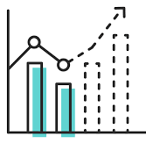
Download links
Udemy Course: https://www.udemy.com/machinelearning/
Download Rstudio: https://www.rstudio.com/products/rstudio/download/
Download Anaconda: https://www.anaconda.com/distribution/
Extra material (pass inside ml course): https://www.superdatascience.com/pages/machine-learning
Teachers profiles in Linkedin:
Hadelin
https://www.linkedin.com/in/hadelin-de-ponteves-1425ba5b/
Kirill
https://www.linkedin.com/in/keremenko/?originalSubdomain=au
<number> / evalueserve.com
©2017 Evalueserve. All rights reserved.

Slide 16
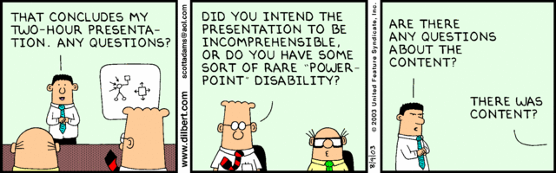
Enjoy Machine Learning
;)
©2017 Evalueserve. All rights reserved.

